Slide 1
Programming the 8051

Slide 2
8051 syntax
Label : Instruction ; comment
Assembly language Instruction Line

Slide 3
Labels
A label can be any combination at up to 128 letters (A-Z) numbers (0-9); Underline (=) and question Mark(?)
It cannot begin with any decimal number 0-9
  Example--
    Fred.2:
    Square :
    Tabletwo:
    Transmit :
    Receive :
    Send :

Slide 4
Labels
Label should be placed in the first text column on the far left
Label should not be an instruction
  Example
    DPH
    MOV
    jmp

Slide 5
Instruction
An 8051 instruction is any of the coded set that have been manufactured of the 8051
Every instruction can be converted into a unique machine-language binary code .
Each instruction generally made up of three distinct parts-
  Instruction 1 2 3
  MOV destination source
  (mnemonic) (operands)

Slide 6
Part 1
  The instruction mnemonic to be performed by CPU
  Move the data from one location in the source and other in destination
  Part 2
  It is called an operand or data address
  It specifies the destination for data that is being copied from the source
  The names of the destination and source are separated by (,)
  Part 3
  Comments are included by the programmer
  Comments begin with semicolon (;)
  ; this is a comment
  ; and so is this
  ; mov a,b
  ; and so on

Slide 7
Data Transfer Instructions

Slide 8
Data Transfer Instructions
Computer typically spends more time moving data from one location to other
Data is stored in the source and moved to destination .
The 8051 mnemonics are written with destination address first , followed by source
Mov destination source
PUSH source or POP destination
XCH destination source

Slide 9
Data Transfer Instructions
MOV dest, source dest ← source
Stack instructions
  PUSH byte ;increment stack pointer, ;move byte on stack
  POP byte ;move from stack to byte, ;decrement stack pointer
Exchange instructions
  XCH a, byte ;exchange accumulator and byte

Slide 10
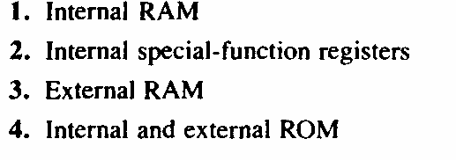
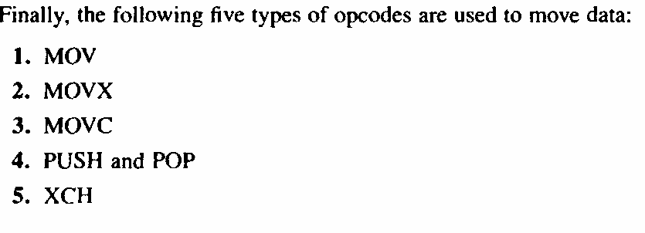
Four distinct physical parts

Slide 11
Addressing Modes
Four addressing modes are used to acces data :
  Immediate addressing mode
  Register addressing mode
  Direct addressing mode
  Indirect addressing mode

Slide 12
8051 Instruction Format
immediate addressing
    add a,#3dh ;machine code=243d
Direct addressing
    mov r3,0E8h ;machine code=ABE8
Op code
Immediate data
Op code
Direct address

Slide 13
8051 Instruction Format
Register addressing
  070D E8 mov a,r0 ;E8 = 1110 1000
  070E E9 mov a,r1 ;E9 = 1110 1001
  070F EA mov a,r2 ;EA = 1110 1010
  0710 ED mov a,r5 ;ED = 1110 1101
  0711 EF mov a,r7 ;Ef = 1110 1111
  0712 2F add a,r7
  0713 F8 mov r0,a
  0714 F9 mov r1,a
  0715 FA mov r2,a
  0716 FD mov r5,a
  0717 FD mov r5,a
Op code | n | n | n

Slide 14
8051 Instruction Format
Register indirect addressing
  mov a, @Ri ; i = 0 or 1
  070D E7 mov a,@r1
  070D 93 movc a,@a+dptr
  070E 83 movc a,@a+pc
  070F E0 movx a,@dptr
  0710 F0 movx @dptr,a
  0711 F2 movx @r0,a
  0712 E3 movx a,@r1
Op code | i

Slide 15
Instruction Using #
Next bytes Are Data
Immediate Addressing Mode
Instruction Using R0 to R7
Source or destination of data
Register R0 to R7 in current bank
Register Addressing Mode
Instruction Using a RAM Address
Address in RAM
Direct Addressing Mode
Instruction using @R0 or @R1
Register R0 or R1 in current bank
Address of Data
Address in RAM
Indirect Addressing Mode

Slide 16
Immediate Addressing Mode
The source operand is a constant ,when the instruction the operands comes immediately after the opcode
The immediate data must be preceded by the pond sign (#)
The simplest way to get data to a destination
is to make the source of the data parts of the opcode.
When 8051 executes an immediate data move the program counter is automatically incremented .

Slide 17
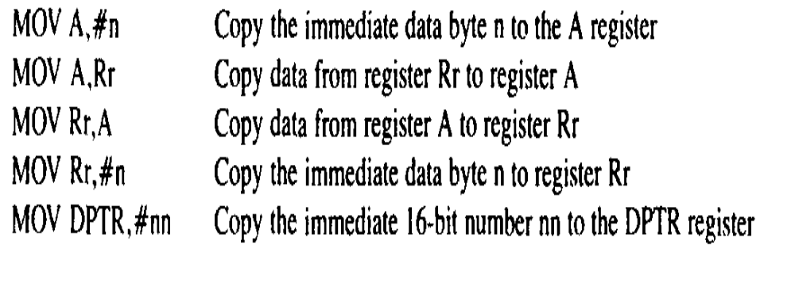

Slide 18
Addressing Modes
Immediate Mode – specify data by its value
  mov A, #0 ;put 0 in the accumulator
  ;A = 00000000
  mov R4, #11h ;put 11hex in the R4 register
  ;R4 = 00010001
  mov B, #11 ;put 11 decimal in b register
  ;B = 00001011
  mov DPTR,#7521h ;put 7521 hex in DPTR
  ;DPTR = 0111010100100001

Slide 19
Register Addressing Mode
It involves the use of register to hold the data to be manipulated
In this addressing mode the source and destination register must be match in size and moving data in between the accumulator
The movement of register Rn is not allowed
Example R4, R7 is not valid

Slide 20
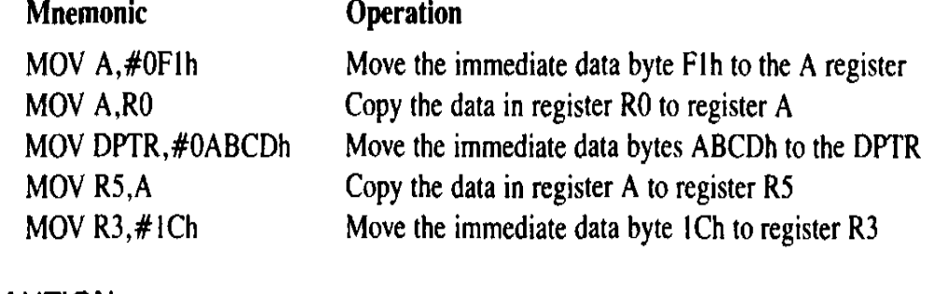
Mov A, Rr copy data from register Rr to register A
MOV Rr,A copy data from register A to register Rr

Slide 21
Addressing Modes
Register Addressing – either source or destination is one of CPU register
MOV R0,A
  MOV A,R7
  ADD A,R4
  ADD A,R7
  MOV DPTR,#25F5H
  MOV R5,DPL
  MOV R,DPH
Note that MOV R4,R7 is incorrect

Slide 22
Direct Addressing Mode
The 128 bytes of RAM has been assigned addresses 00 to 7Fh
RAM location 00-1Fh is register banks and stack
20-2Fh are set aside as bit –addressable space to save the single bit data
30-7Fh are available as a place to save byte size data
In this the data is in a RAM memory location whose address is known and this address is a given part of the instruction .

Slide 23
Direct Addressing Modes
Direct Mode – specify data by its 8-bit address
Usually for 30h-7Fh of RAM
  Mov a, 70h ; copy contents of RAM at 70h to a
  Mov R0,40h ; copy contents of RAM at 70h to a
  Mov 56h,a ; put contents of a at 56h to a
  Mov 0D0h,a ; put contents of a into PSW

Slide 24
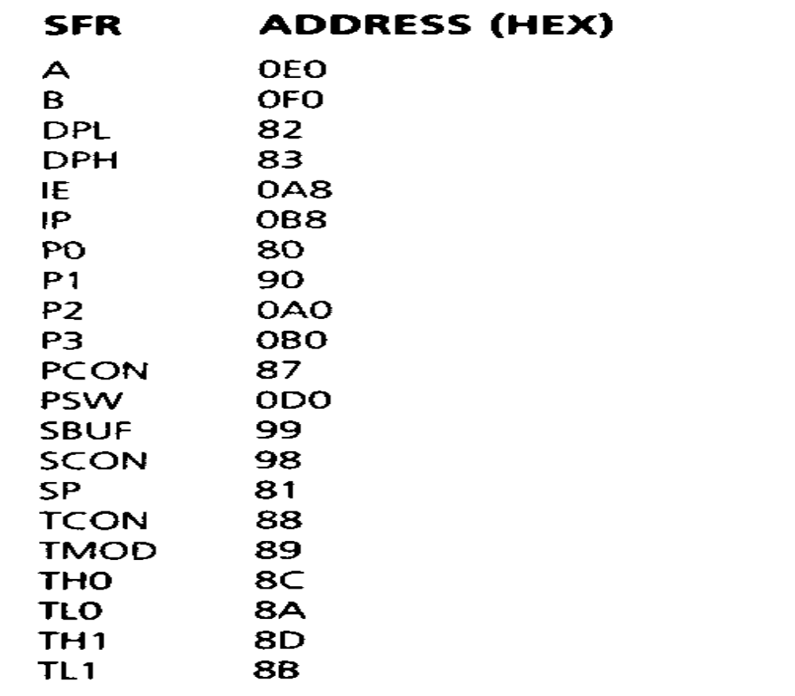

Slide 25
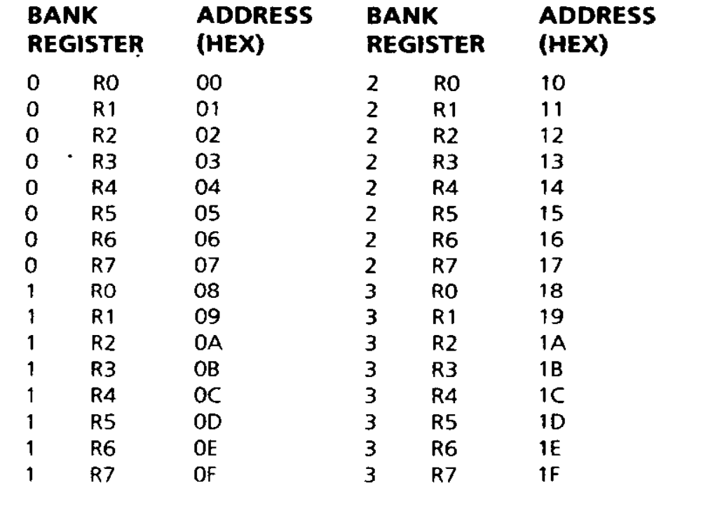

Slide 26
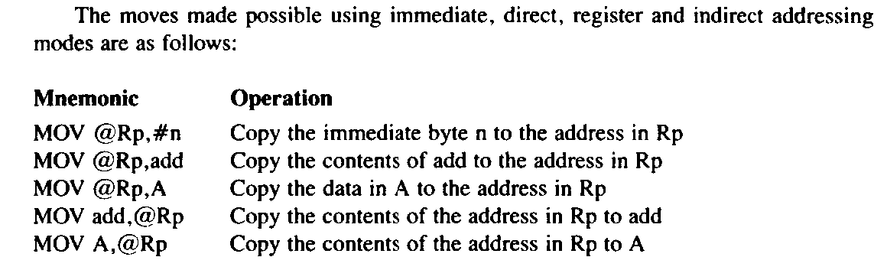
Indirect Addressing Mode

Slide 27
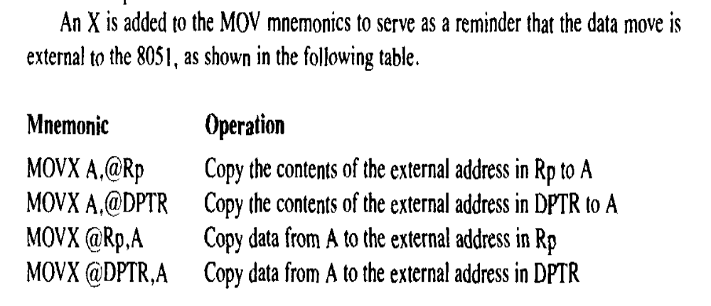
External Data Moves

Slide 28
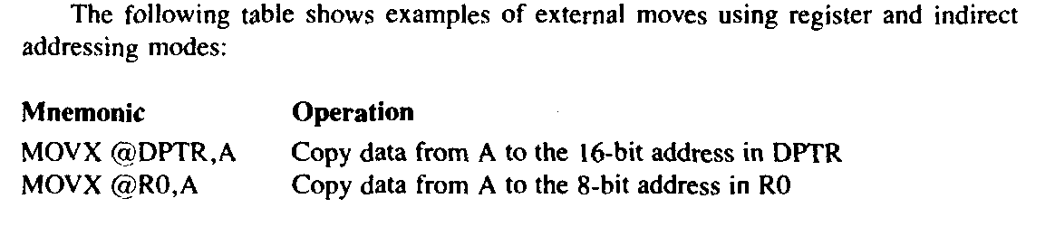

Slide 29
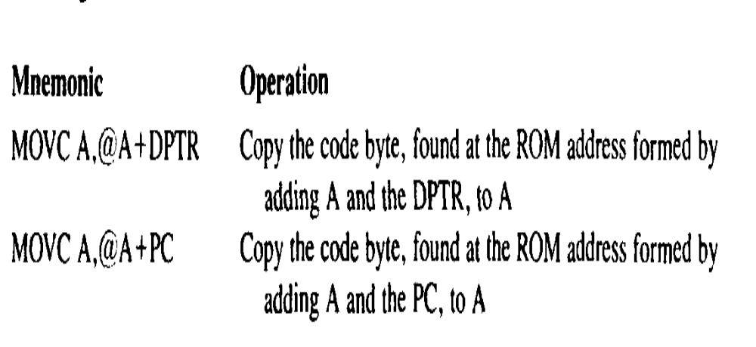

Slide 30
Exchange Instructions
two way data transfer
  XCH a, 30h ; a ←→ M[30]
  XCH a, R0 ; a ←→ R0
  XCH a, @R0 ; a ←→ M[R0]
  XCHD a, R0 ; exchange “digit”
a[7..4] a[3..0]
R0[7..4] R0[3..0]
Only 4 bits exchanged

Slide 31
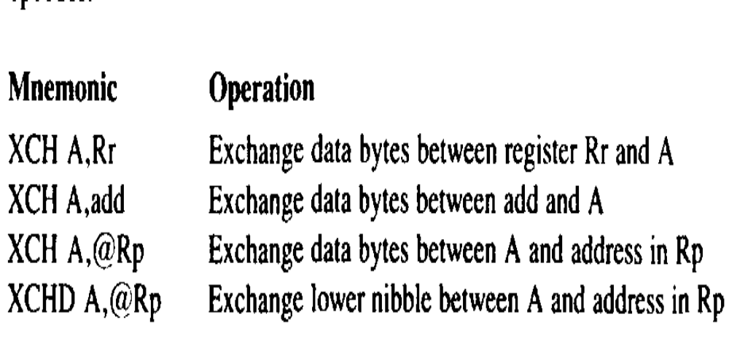

Slide 32
